Slide 1
BeachFit and Wellbeing Site Redesign

Slide 2
Purpose
Site is a showcase for the business, target audience is new users rather than existing members. It is used for customer acquisition rather than customer retention.
Create a site where Client has the ability to edit elements, giving them more control over the website.

Slide 3
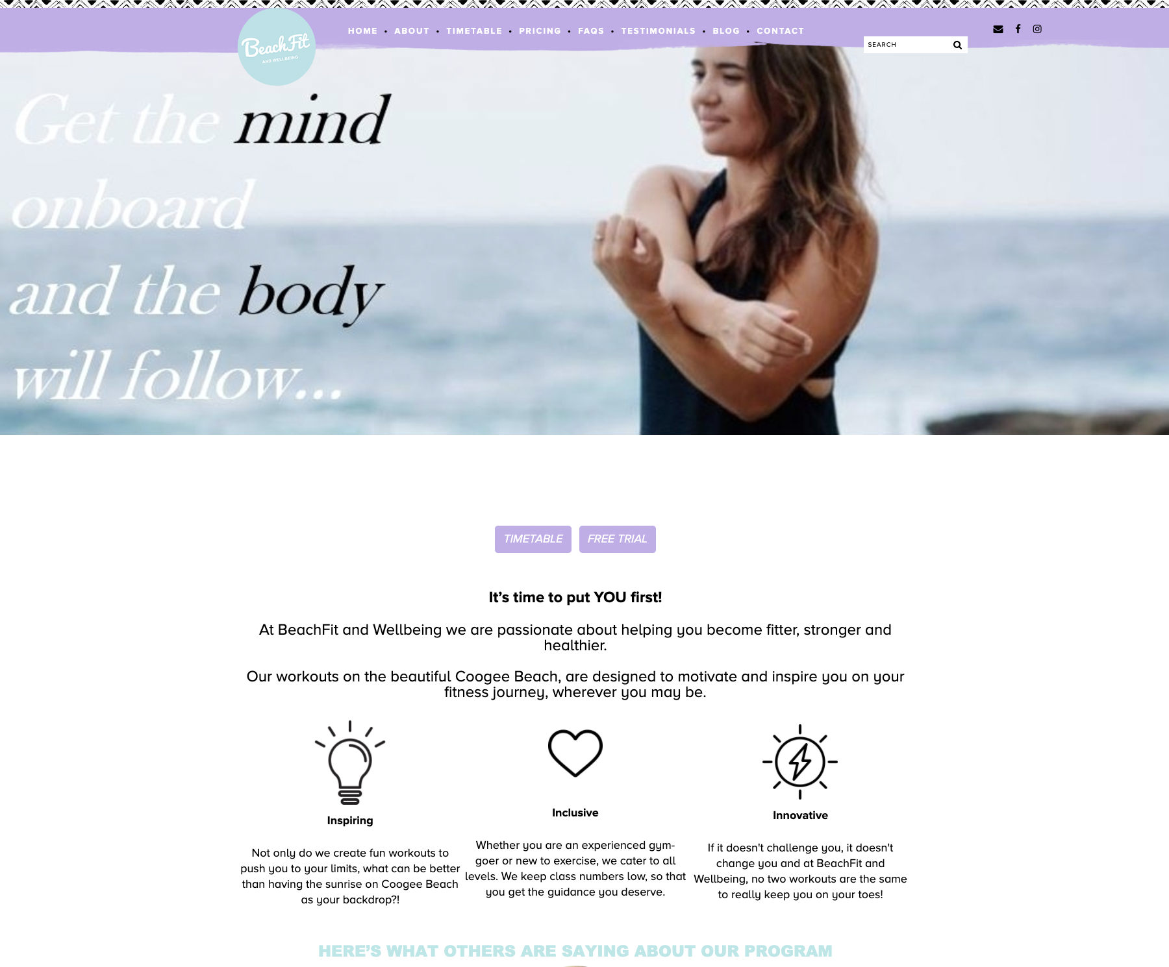
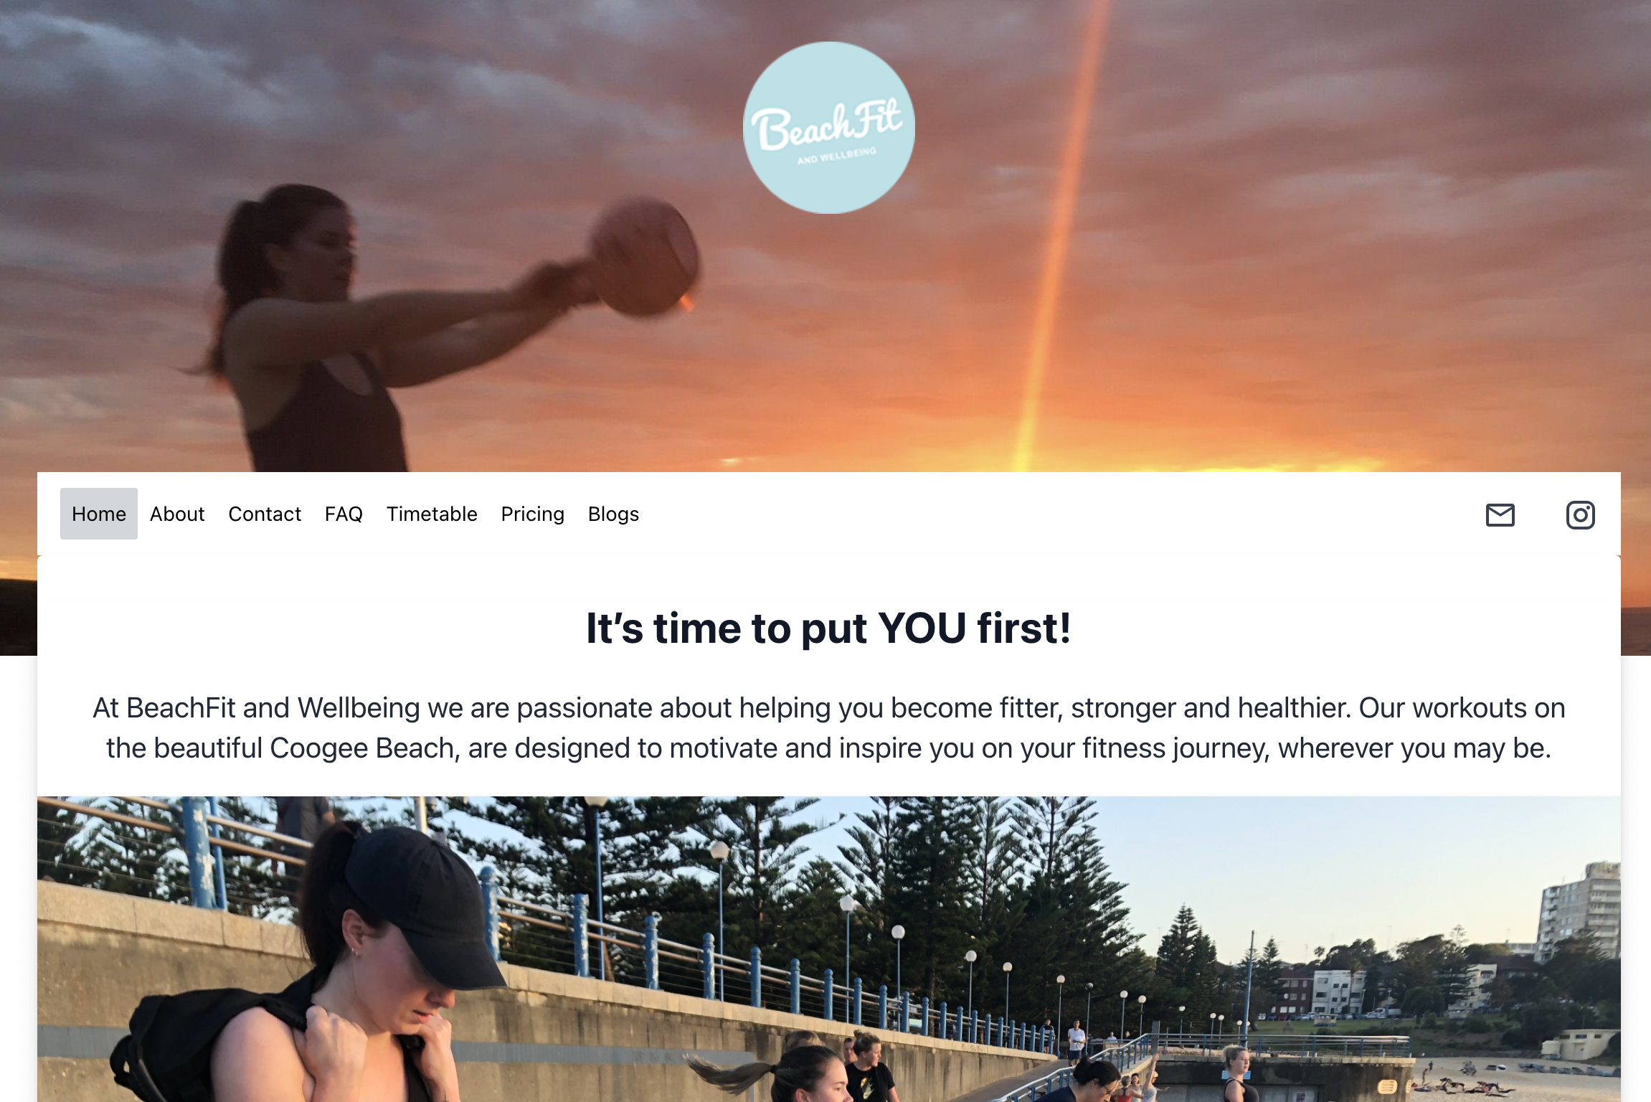
Before & After

Slide 4
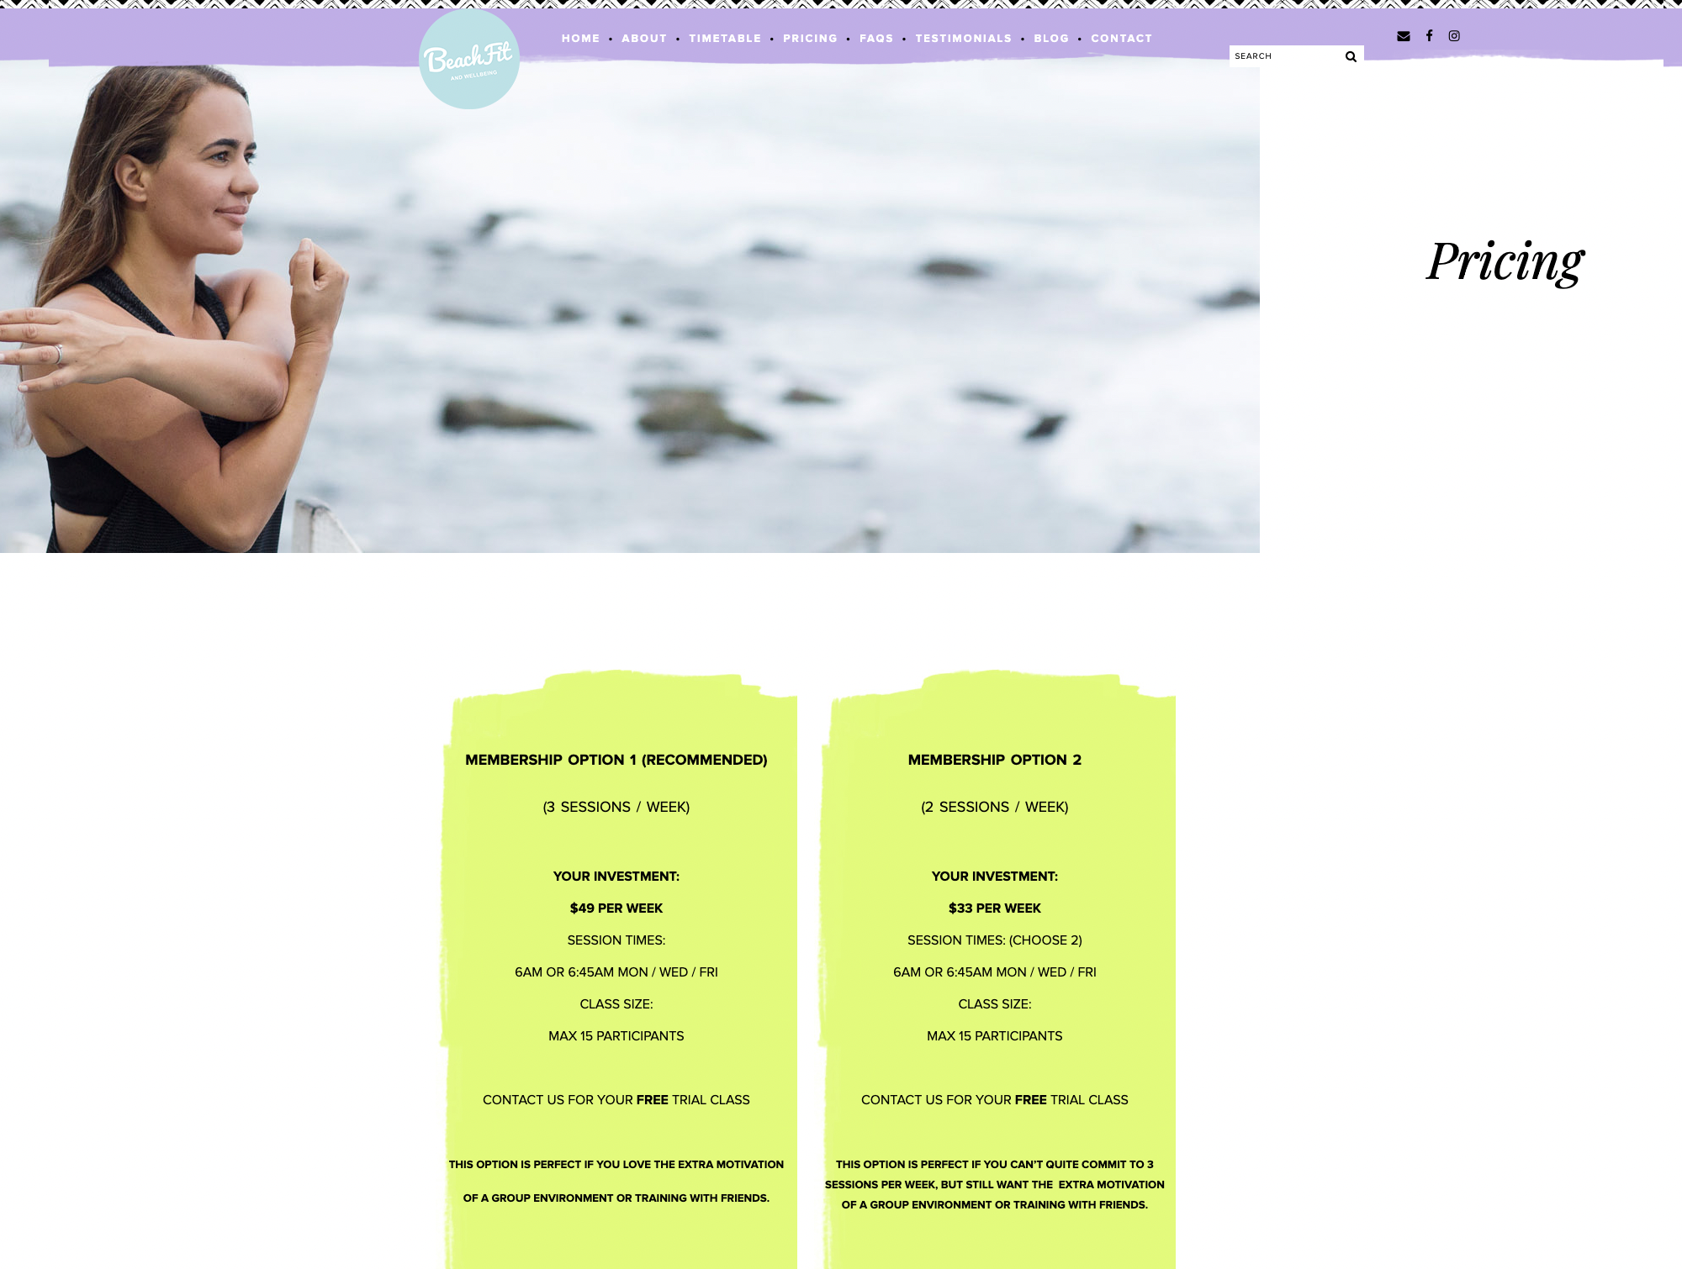
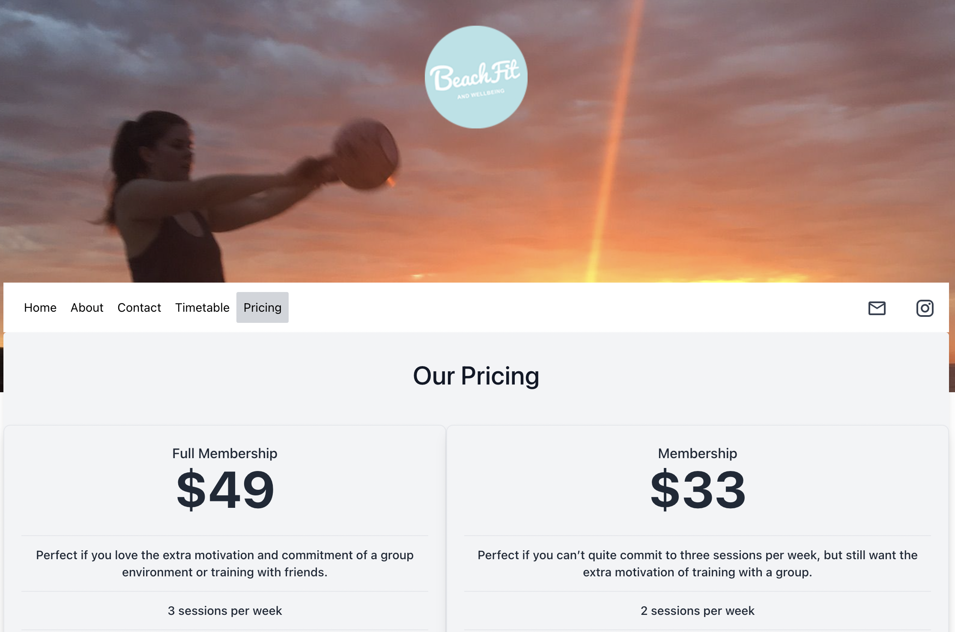
Before & After

Slide 5
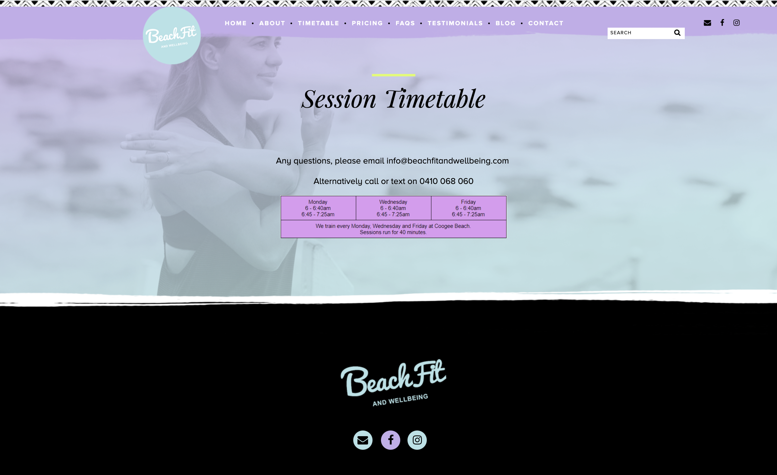
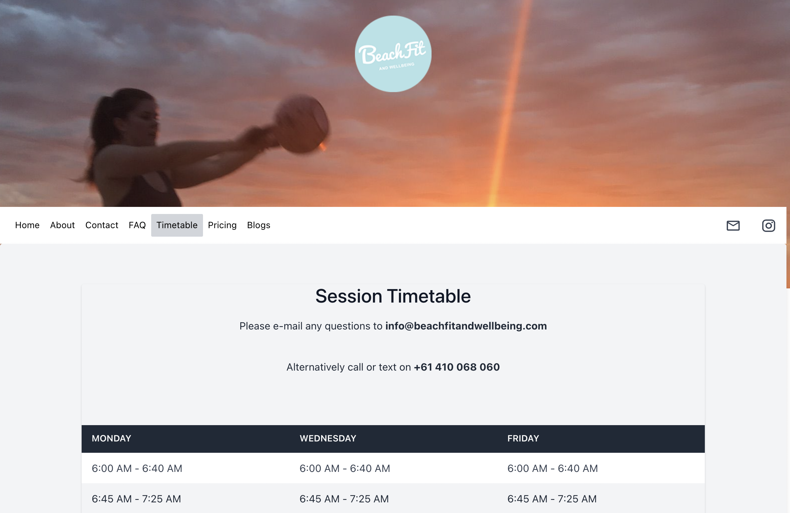
Before & After

Slide 6
How They Compare
PREVIOUS SITE
No ability for Client to edit, could only be changed in code.
Site was not fully responsive, and components did not align.
Design was dated and inconsistent, content was from previous owner.
CURRENT SITE
Client has an Admin dashboard. Can edit Pricing, FAQs and Blogs.
Site is full responsive for all formats.
Design has been updated, consistent across all pages. All content rewritten and updated.

Slide 7


Stretch Targets
Blog page – Administrator to edit
Search bar
Link to booking classes
Live chat
Deployment to original domain name ????
Add randomised photo to Homepage

Slide 8
Code
Live Demo

Slide 9
Learnings
Working with Client
Making sure website was what they needed, not what we wanted to do.
Complementary skillsets
Importance of collaboration, and delegation of tasks.
Deployment to existing site
More complex than anticipated to deploy to an existing name.

Slide 10
Client Feedback
“I felt really listened to in the whole process. Punit & Sarah were really receptive of what I wanted for the site, they did an outstanding job. Being able to edit it myself has made me feel empowered!
- Yvonne (Client)

